Slide 1
SU Food Services Database Application
IST- 659
Rahul Rathod
November 26, 2018

Slide 2
Project Goals
Major functions of database application are :
What data to collect ?
Employees and Manager details working at Hall
Shifts that are assigned to employees
Employees weekly hours of work and pay amount
Shift details that are drop by an employee
Shift details that are picked by an employee
Feedback from employees

Slide 3
Project Goals
Who can input data
Administrative Staff
Manager
Employee
Who can query data
Manager
Supervisors
Employee

Slide 4
Project Goals
What are the major data questions?
How to store the number of employees working in a particular dining hall?
How many students are working at a particular time in the hall?
How many students are working in more than one hall?
How many hours a particular employee is working?
What are the shift timings?
How much a hall spends on employees?

Slide 5
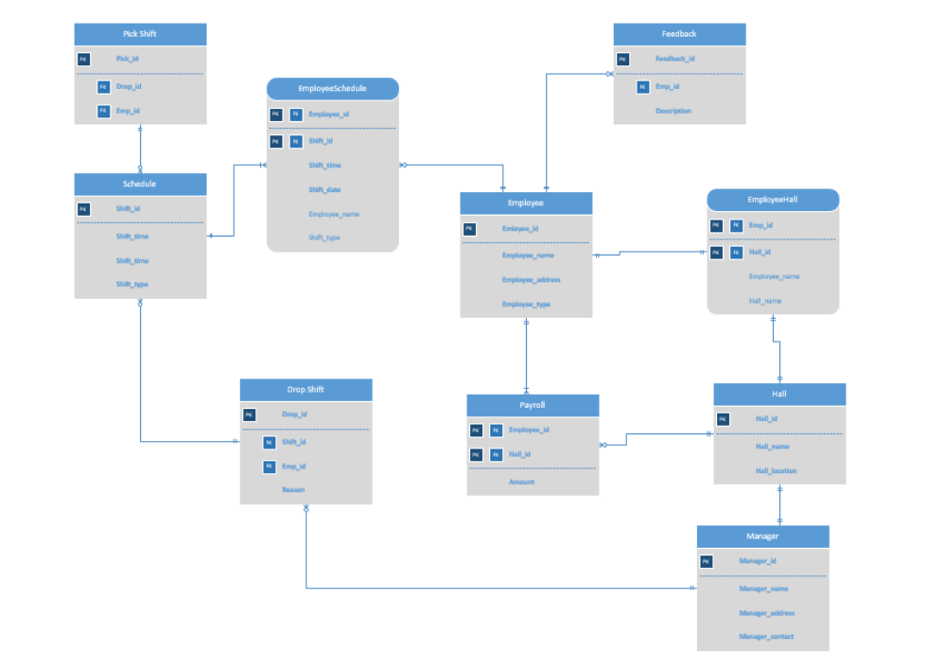
ER-Diagram Visio

Slide 6
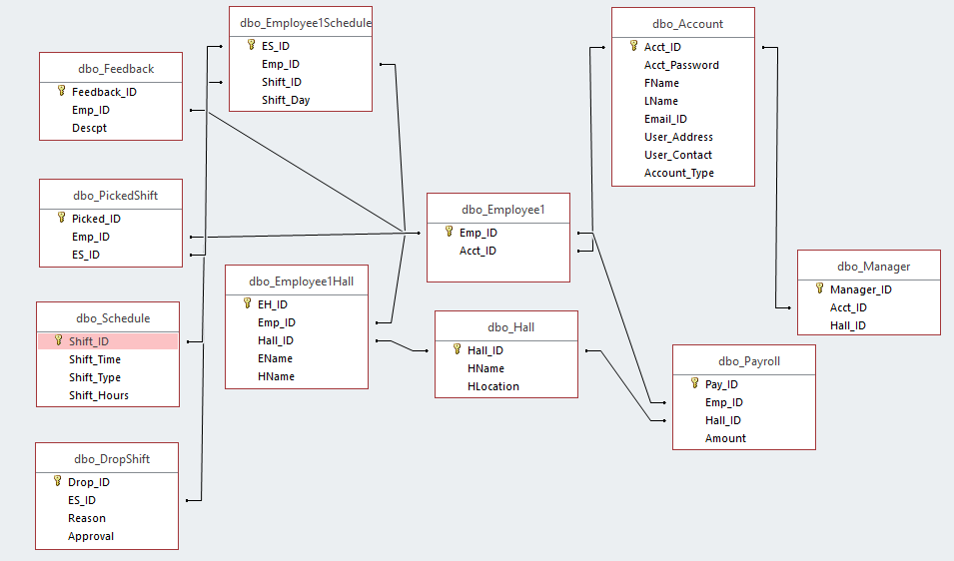
ER-Diagram Access Relationship

Slide 7
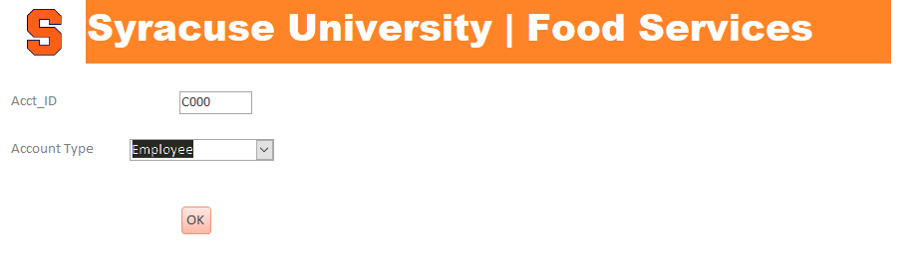
Forms
Form1 allow to enter account id and account type to retrieve details of user

Slide 8
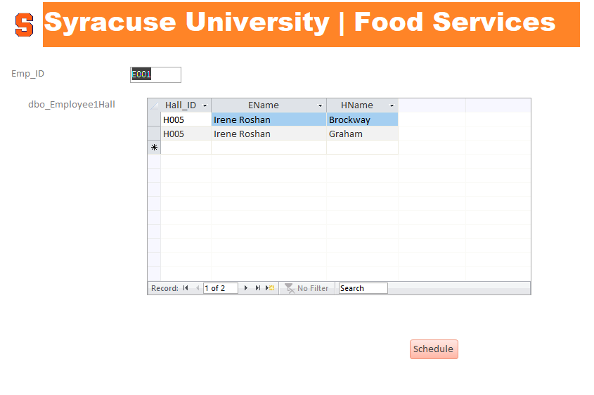
Forms
On click Ok, form2 retrieves data of employee and the halls the employees works

Slide 9
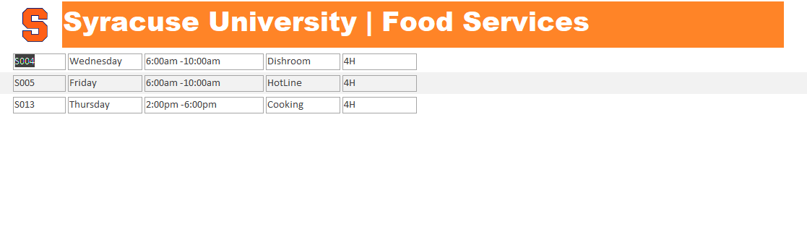
Forms
Form3 gives detail information of the shifts of employee

Slide 10
Major Data Questions Report
How to store the number of employees working in a particular dining hall?
How many students are working at a particular time in the hall?
How many students are working in more than one hall?
How many hours a particular employee is working?
What are the shift timings?
How much a hall spends weekly on employees?

Slide 11
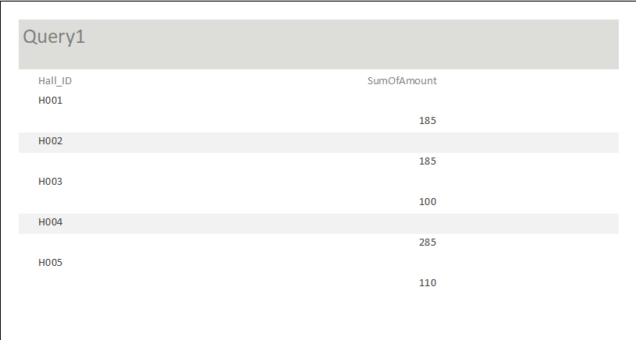
Report 1
How much a hall spends weekly on employees?

Slide 12
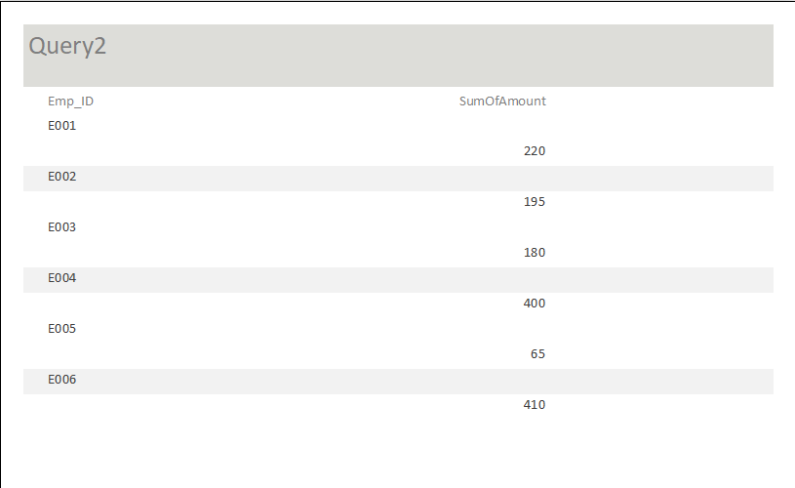
Report 2
How much employee earn weekly from all hall?

Slide 13
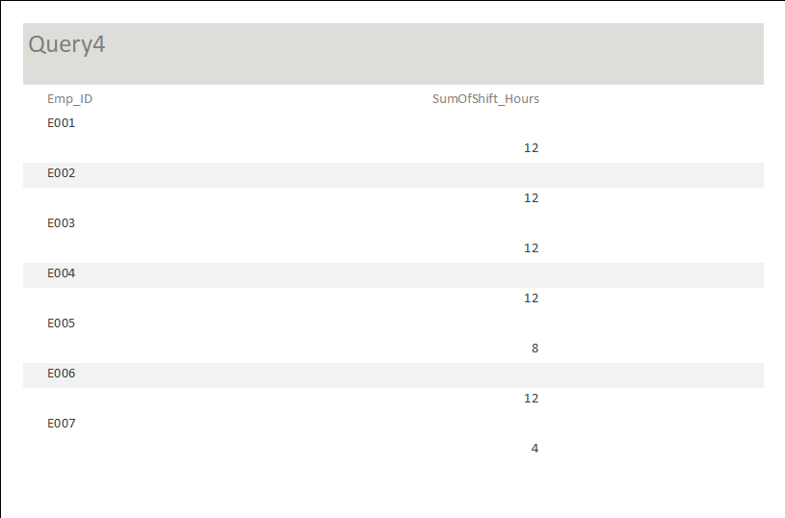
Report 3
How many hours a particular employee is working?

Slide 14
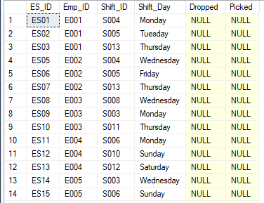
Trigger
Trigger updates the column Dropped in Employee1Schedule table if the employee drops a shift and it is approved
Output Before the Trigger is executed

Slide 15
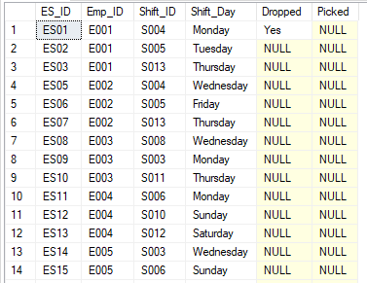
Trigger
Output After the Trigger is Executed
Insert Into DropShift Values('D008','ES01','Sick','Yes')

Slide 16
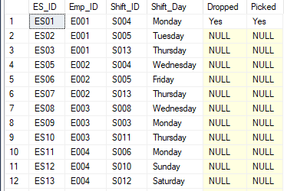
Triggers
Another Trigger is Executed when the shift is picked by an employee
It updates the Picked column of the Employee1Schedule table
Insert Into PickedShift
Values ('P006','E006','ES01')

